Slide 1

Assignment -2
Jay Panchal
100960958

Slide 2


Agenda
Rationale Statement
Learning Curve
Model Summary & Detailed Matrix
ROC/AUC Curve
Recommendations for Mr. John Hughes

Slide 3

Rationale Statement
The primary objective of this project is to develop a Logistic Regression model for Mr. John Hughes utilizing the WheatData.csv dataset, which comprises 210 observations and 8 variables. The dataset includes essential independent variables—area (A), perimeter (P), compactness (C), length of kernel (LK), width of kernel (WK), asymmetry coefficient (A_coef), and length of kernel groove (LkG)—to effectively predict the risk levels associated with different wheat types.The dependent variable categorizes the wheat into three classes: Kama (0), Rosa (1), and Canadian (2). By employing a Logistic Regression model, we aim to identify the likelihood of each wheat type based on the provided features.

Slide 4
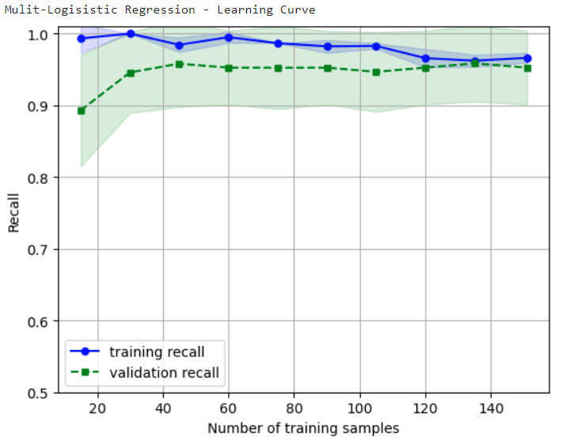
Learning Curve
The learning curve for the Logistic Regression model illustrates the recall on both the training and validation sets across increasing numbers of training samples. Here's an interpretation based on the curve provided:
High Training Recall Across All Samples:
The model consistently shows high training recall, maintaining values close to 1.0 throughout. This indicates that the Logistic Regression model is performing exceptionally well on the training set and is able to fit the data with high accuracy.
Stabilization of Validation Recall:
The validation recall starts slightly lower but stabilizes around 0.9 as more samples are used for training. The slight gap between training and validation recall suggests that while the model is generalizing well, some minor overfitting may be occurring. However, the gap is not large, meaning the model is quite robust.

Slide 5
Summary Of Confusion Matrix
Model Details: Model Name: LogisticRegression(max_iter=1000, multi_class='multinomial', random_state=100, solver='newton-cg’)
Best Parameters:{'clf__C': 100, 'clf__penalty': 'l2', 'clf__solver': 'newton-cg’}
Summary Metrics: Overall Accuracy: 93% Macro Average Precision: 0.93 Macro Average Recall: 0.93 Macro Average F1-Score: 0.93 Weighted Average Precision: 0.93 Weighted Average Recall: 0.93 Weighted Average F1-Score: 0.93

Slide 6
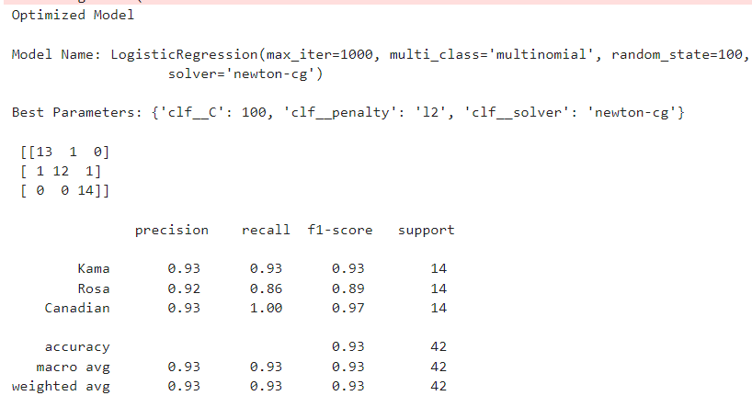
Summary Of Confusion Matrix
Detailed Insights: Kama Class: Precision: 0.93Indicates that 93% of the instances predicted as Kama are actually Kama. Recall: 0.93Reflects that 93% of actual Kama instances were correctly identified. F1-Score: 0.93Shows a balanced performance for Kama, suggesting the model has high reliability for this class. Support: 14Number of true instances of the Kama class.
Rosa Class:
Precision: 0.92Indicates that 92% of the instances predicted as Rosa are actually Rosa.
Recall: 0.86Shows that the model correctly identifies 86% of actual Rosa instances.
F1-Score: 0.89Suggests some trade-off between precision and recall; the lower recall indicates room for improvement in correctly classifying Rosa.
Support: 14Number of true instances of the Rosa class.

Slide 7
Summary Of Confusion Matrix
Detailed Insights: Canadian Class:
Precision: 0.93Suggests that when the model predicts Canadian, it is correct 93% of the time.
Recall: 1.00Indicates that the model perfectly identifies all Canadian instances.
F1-Score: 0.97Reflects a very strong performance with both high precision and recall for Canadian wheat.
Support: 14Number of true instances of the Canadian class.

Slide 8
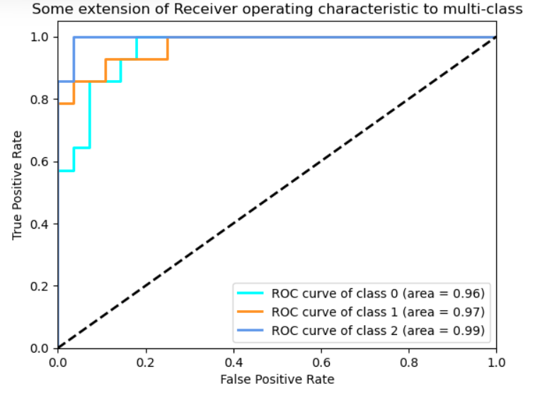
ROC/AUC Curve
Understanding the Plot :
The image presents a Receiver Operating Characteristic (ROC) curve for a multi-class classifier. Each line represents a different class, and the area under the curve (AUC) for each class is provided.
True Positive Rate (TPR): The proportion of actual positive cases that are correctly classified.
False Positive Rate (FPR): The proportion of actual negative cases that are incorrectly classified as positive.
Key Insights :
Overall Model Performance:
High AUC Values: The AUC values for all three classes (0.96, 0.97, and 0.99) are relatively high, indicating that the model performs well overall. This means the model is capable of distinguishing between different classes with a reasonable degree of accuracy.
Class-wise Performance: While the overall performance is good, there are slight variations in the AUC values across the classes. Class 2 seems to have the highest performance, followed by class 1 and then class 0. This suggests that the model might be slightly better at differentiating class 2 from the others compared to class 0.
Trade-off Between Sensitivity and Specificity:
ROC Curve Shape: The shape of each ROC curve reveals the trade-off between sensitivity (TPR) and specificity (1 - FPR). A curve that is closer to the top-left corner indicates a better balance between the two.
Class-wise Trade-off: Analyzing the shapes of the individual curves can provide insights into how the model balances sensitivity and specificity for each class. For example, if a curve is more steeply sloped, it might indicate that the model is more sensitive to positive cases for that class, but at the cost of higher false positive rates.

Slide 9
Recommendations for Mr. John Hughes
1. Feature Engineering and Inclusion of Additional Variables:
Recommendation: Consider exploring additional features that could enhance the predictive power of the model. The key features identified in the analysis are P (perimeter), LK (length of kernel), and LKG (length of kernel groove). However, other characteristics related to wheat, such as moisture content, protein levels, or environmental conditions during growth, may provide valuable information that can improve model accuracy.
Explanation: By expanding the dataset to include these additional variables, Mr. Hughes could capture more nuances in the data, allowing the model to learn better and make more informed predictions. This would potentially lead to a more robust model, reducing the chance of misclassification and improving the overall reliability of the risk assessments.
2. Regular Model Evaluation and Updating:
Recommendation: Implement a routine for regular evaluation and updating of the logistic regression model as new data becomes available. This could include retraining the model with new observations or adjusting the parameters based on shifts in data distribution or trends over time.
Explanation: Given that agricultural conditions can vary seasonally and annually, maintaining an up-to-date model will help ensure the predictions remain relevant and accurate. This adaptive approach will allow Mr. Hughes to respond effectively to changes in wheat characteristics or market conditions, ensuring that risk assessments are based on the most current data. Additionally, continuous monitoring of model performance metrics (e.g., precision, recall, F1-score) can help identify when a model retraining is necessary, thus enhancing predictive performance and business outcomes.

Slide 10

Thank you!

